Slide 1
Ship Detection in Satt Image
Course: CSC I1910-4GH Deep Neural Networks
Prof. Michael Grossberg Presented By:
Sujoy Debnath CUNYID: 24080410

Slide 2
Dataset Description
The HRSC2016 dataset contains images from two scenarios including ships on sea and ships close inshore.
The image sizes range from 300*300 to 1500*900 and most of them are larger than 1000*600.
Total 31 Classes
Data source: https://www.kaggle.com/guofeng/hrsc2016

Slide 3
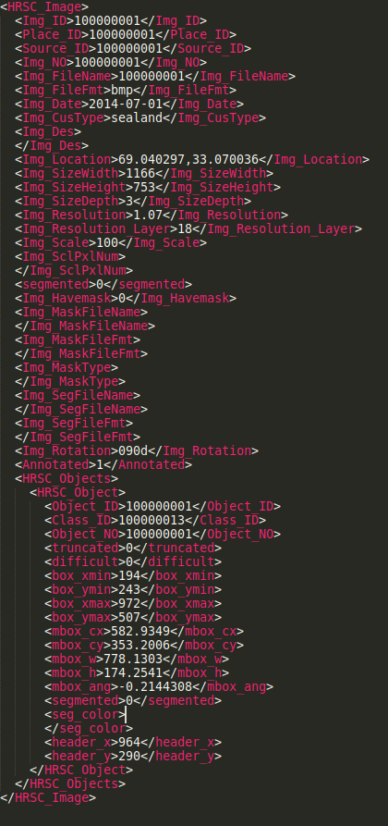
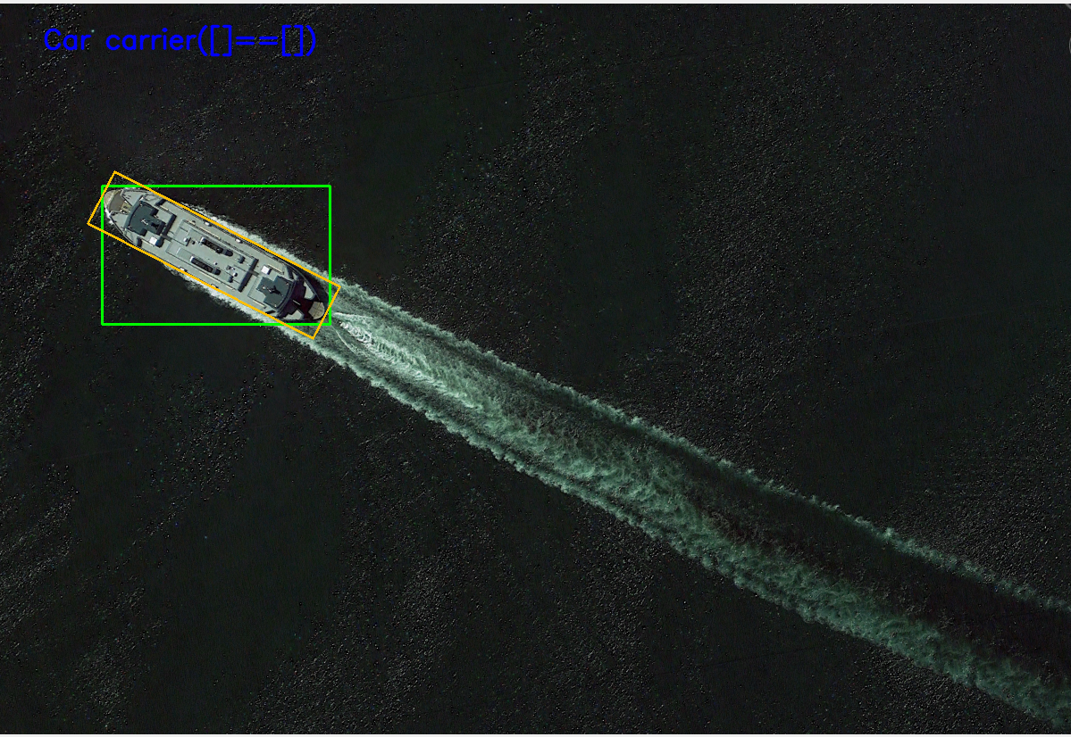
Data Annotations

Slide 4
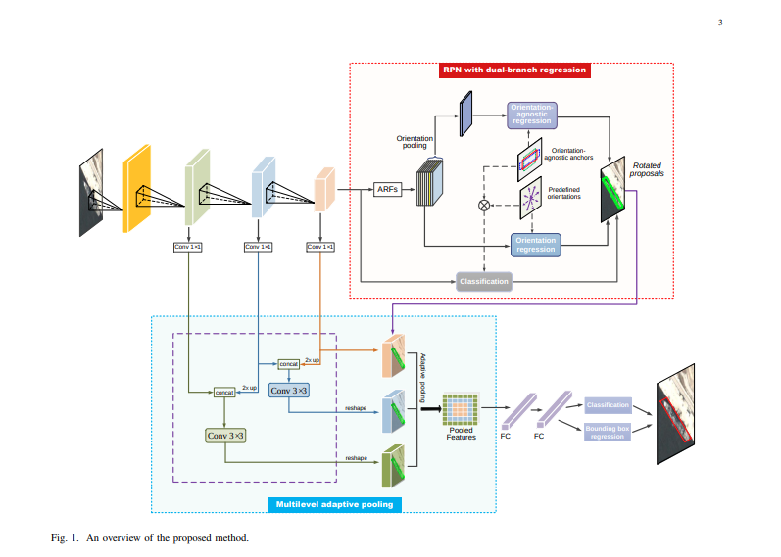
Similar Works
Paper: A Novel CNN-based Method for Accurate Ship Detection in HR Optical Remote Sensing Images via Rotated Bounding Box
Linhao Li, Zhiqiang Zhou, Bo Wang, Lingjuan Miao and Hua Zong
Source:
https://arxiv.org/pdf/2004.07124.pdf

Slide 5
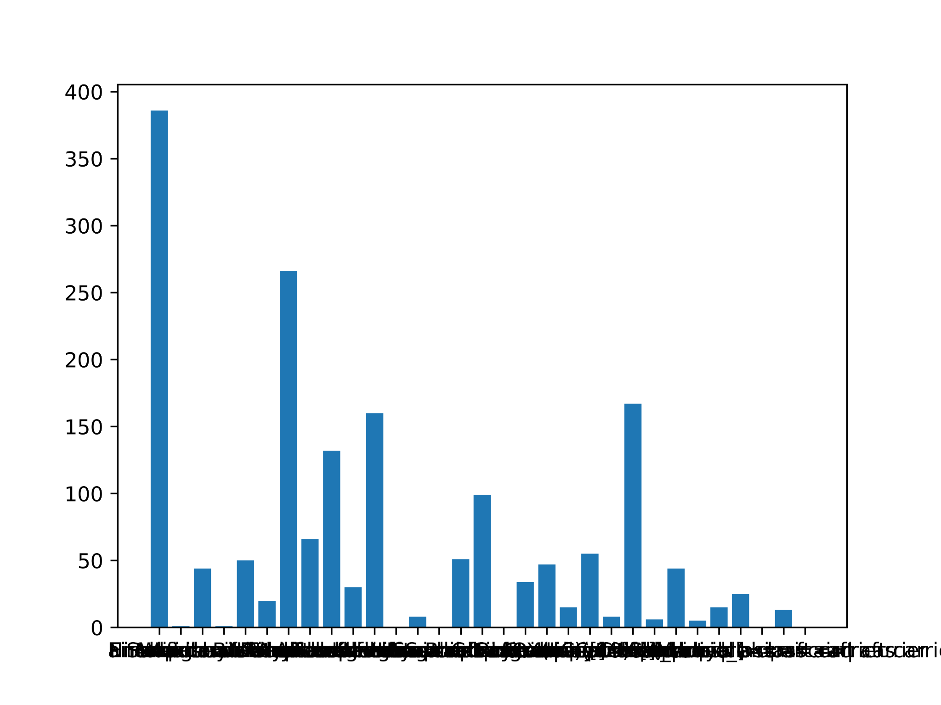
Per Class Data Distribution

Slide 6
Basic Regression Model
Data Format :
Data : Image Data normalized in 3 channels by dividing by 255
ClassLabels : Converted to categorical data
Bboxes : (X_min, Y_min, X_max, Y_max) normalized by dividing by width and height.
ImagePath : Image location
LabelData: One hot encoded label data.

Slide 7
Basic Regression Model
Used VGG16 with ‘imagenet’ weights as the input as features for our model.
Fully Connected layer as Dense layer for Bbox regression with sigmoid activation.
Fully Connected layer as Dense layer for class classification with softmax activation.
Optimizer : Adam with 0.0001 Learning rate.
Losses:
Bbox: Mean Squared Error.
Classes : Categorical Cross entropy.

Slide 8
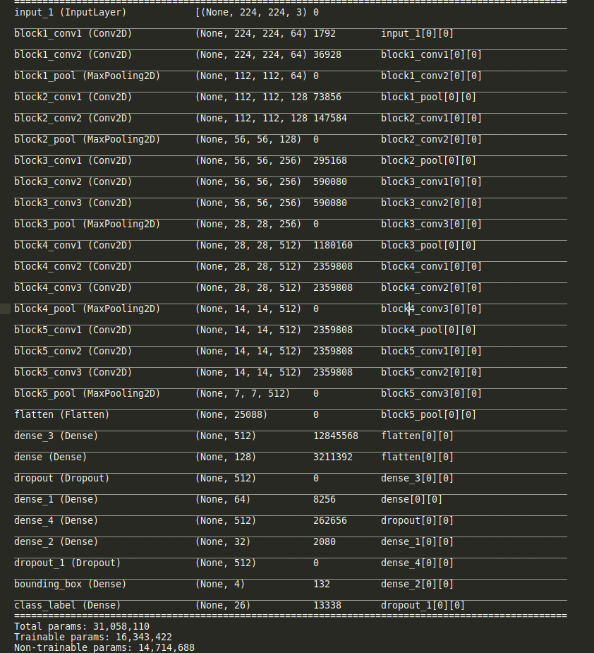
Basic Regression Model Summary

Slide 9
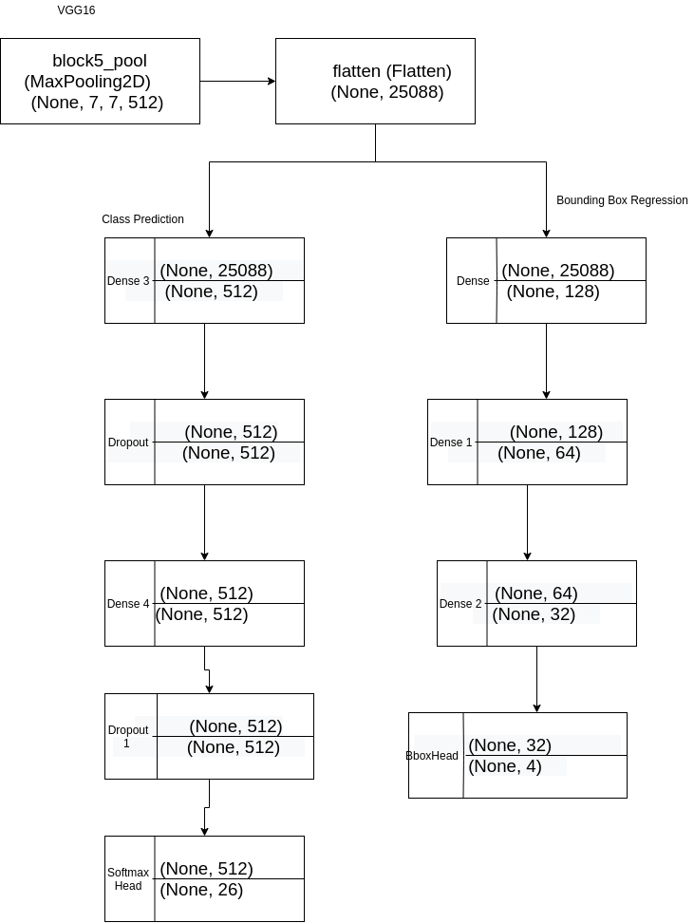
Basic Regression Model Structure

Slide 10
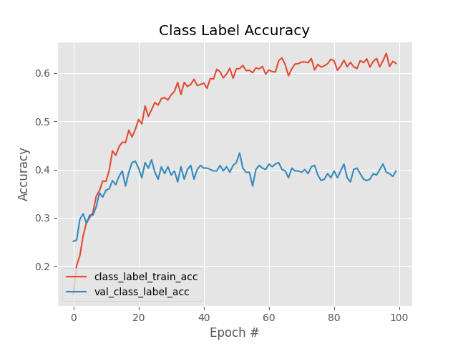
Basic Regression Model Output

Slide 11
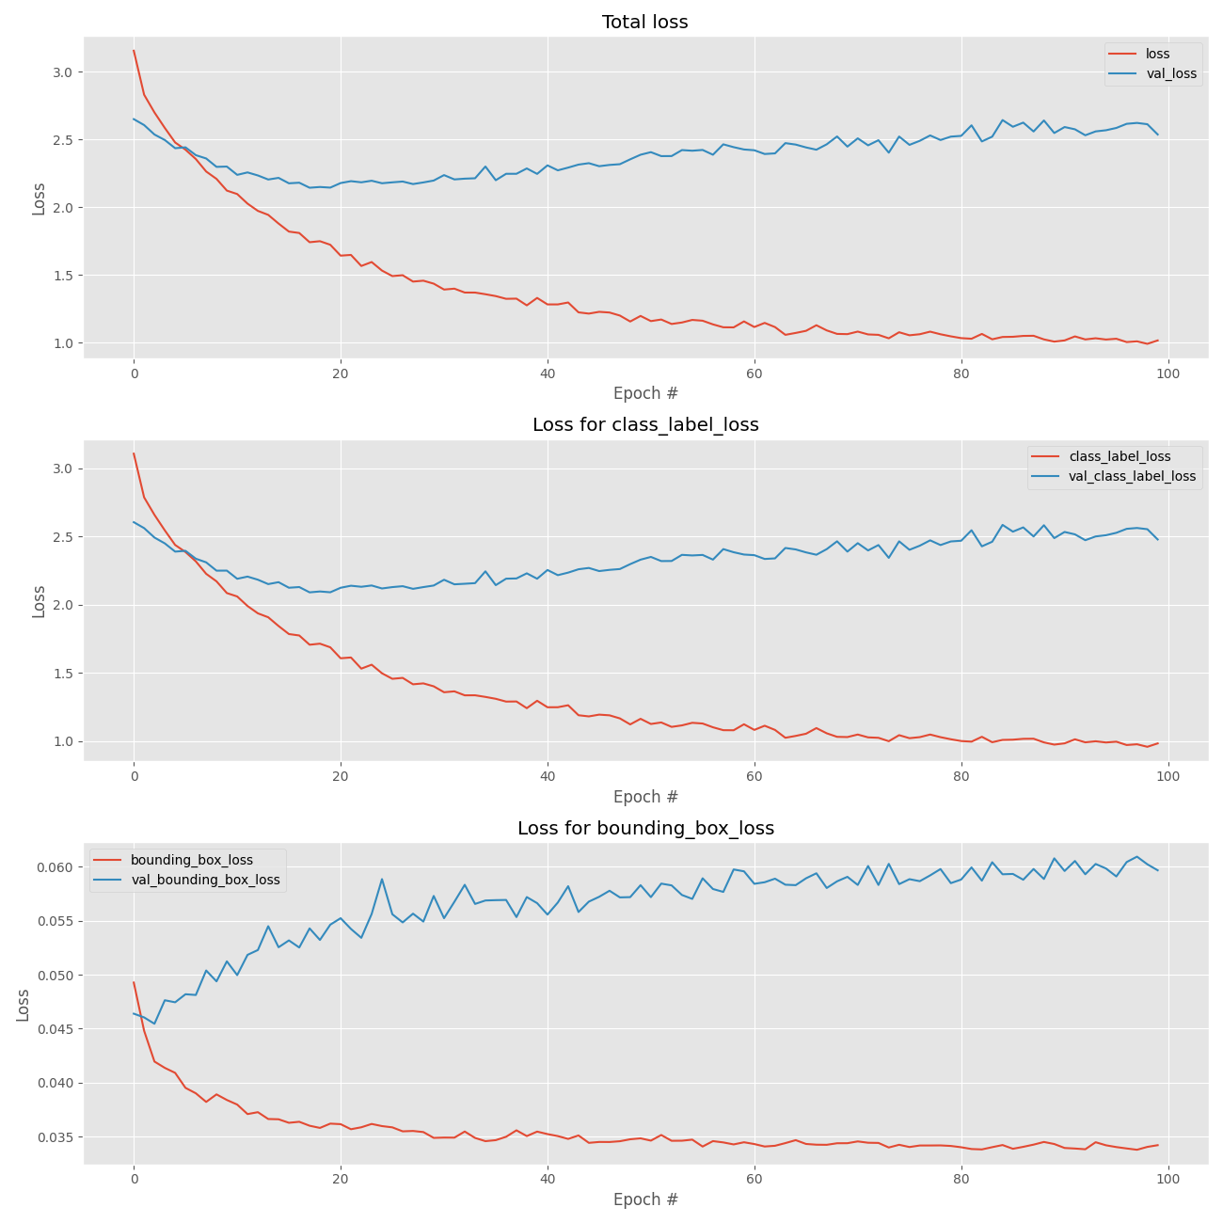
Basic Regression Model Output

Slide 12
Analysis
Clear sign of overfitting.
Steps to take
Stratify the data
Data augmentation
Scikitlearn classification report analysis
Apply other models like Fast R CNN which uses feature pyramid network to compute features.

Slide 13
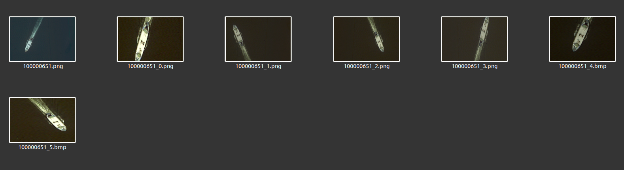
Data Augmentation
Used Parameters for augmentations:
Scaling
Vertical and horizontal flip
Brightness and contrast
Zoom and crop
Output:
Augmented Image
Json file with bounding box and class label data.

Slide 14
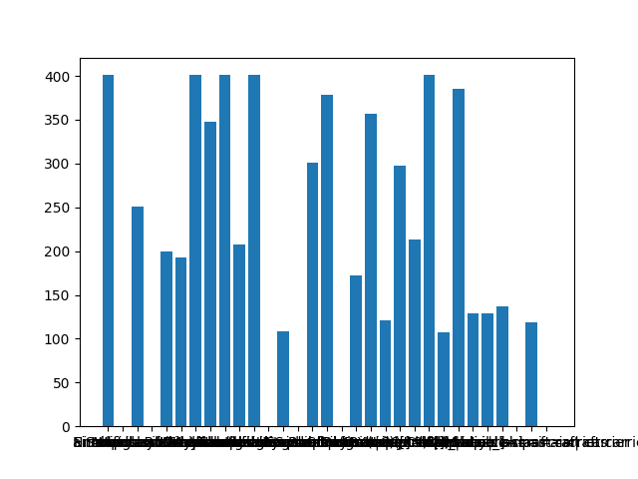
Per class data distribution

Slide 15
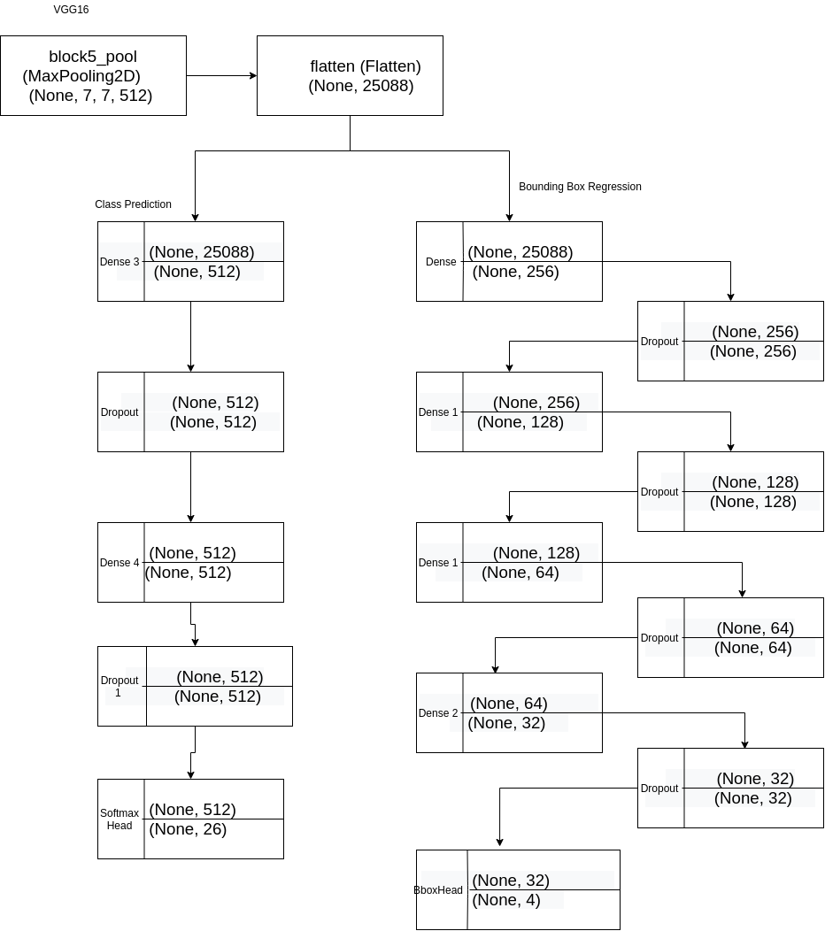
Updated CNN Model

Slide 16
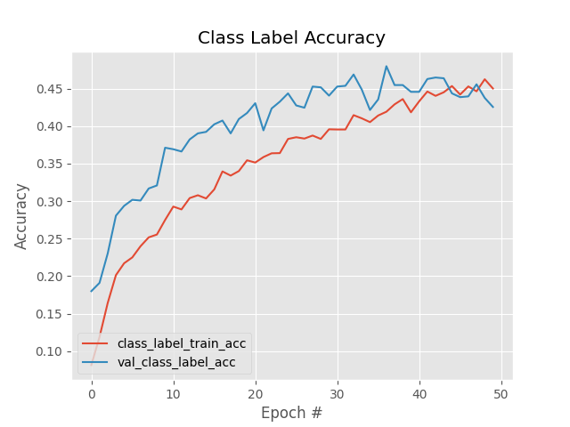
Updated CNN Model Output

Slide 17
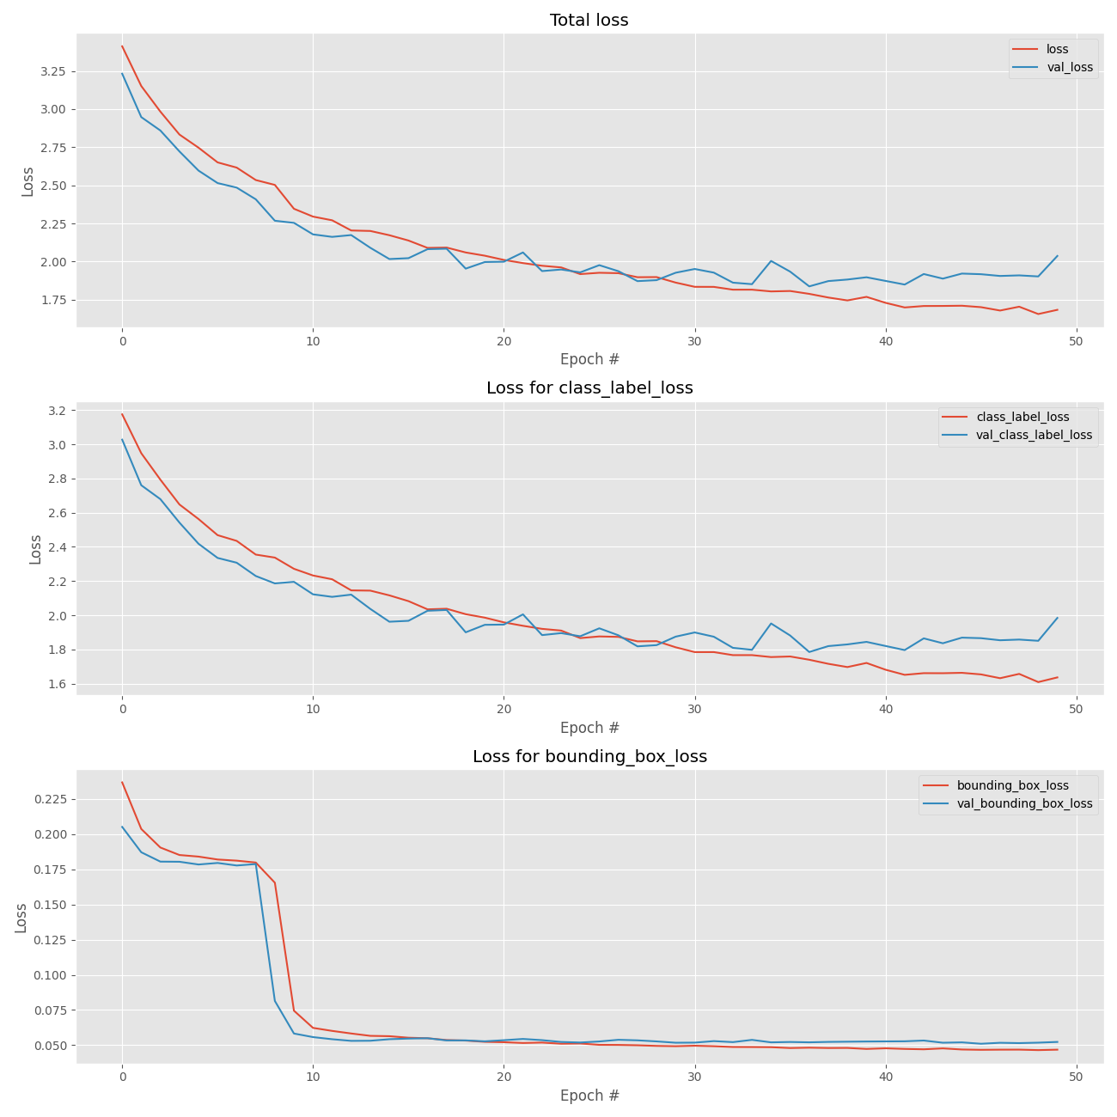
Updated CNN Model Output

Slide 18
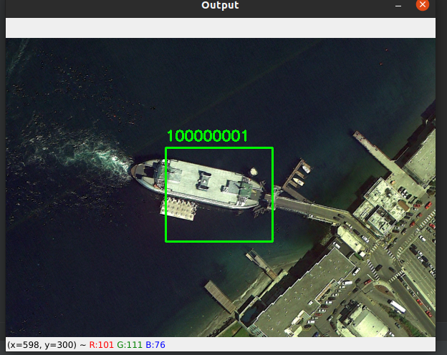
Sample Output results

Slide 19
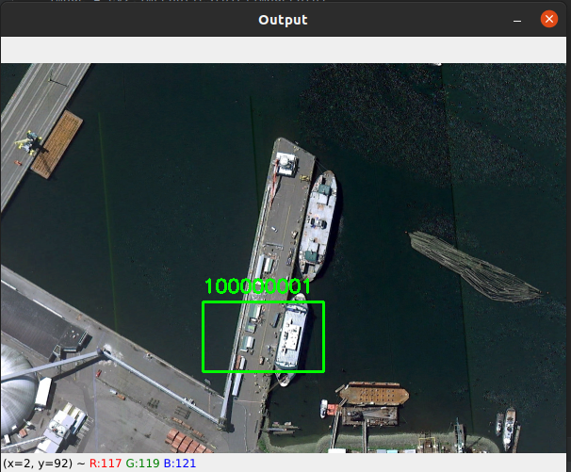
Sample Output results

Slide 20
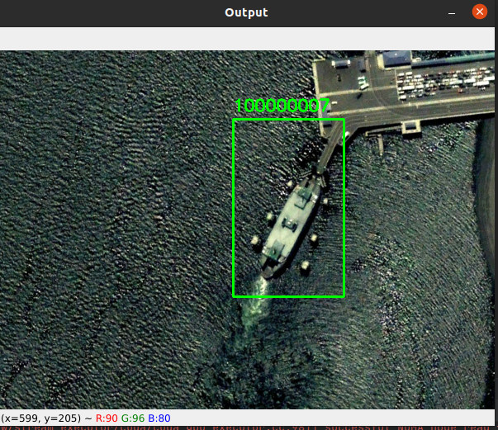
Sample Output results

Slide 21
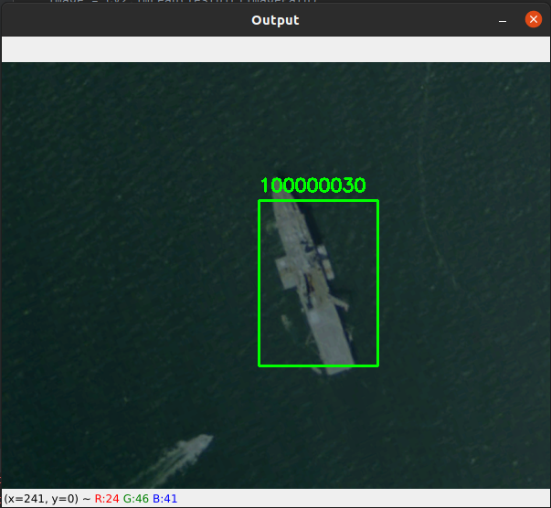
Sample Output results

Slide 22
Limitations
This model can not detect multiple objects in the same image.
R-CNN models like Fast R CNN and Mask R CNN should be able to detect multiple objects in the same image with good accuracy.

Slide 23
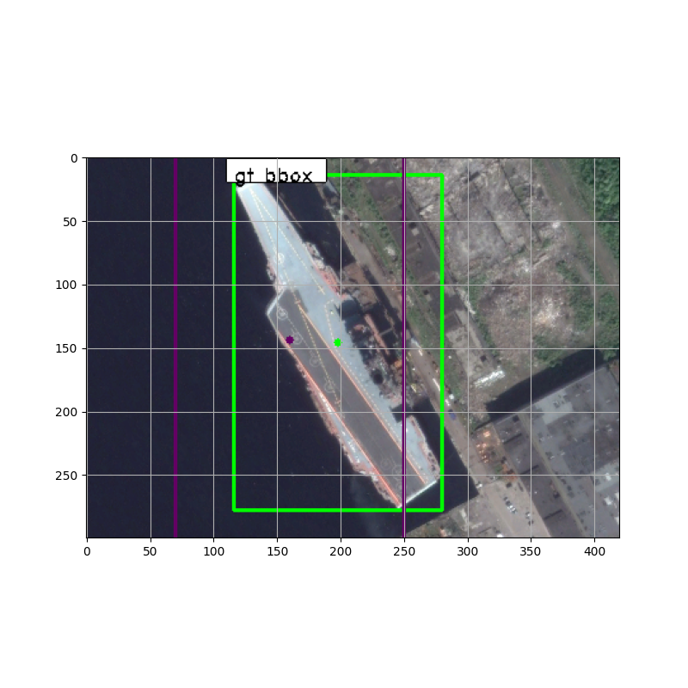
Fast R CNN Model
Fast R CNN model generates bounding box proposals and then calculate IoU with the Ground truth bounding boxes to extract features using Region Proposal Network.

Slide 24
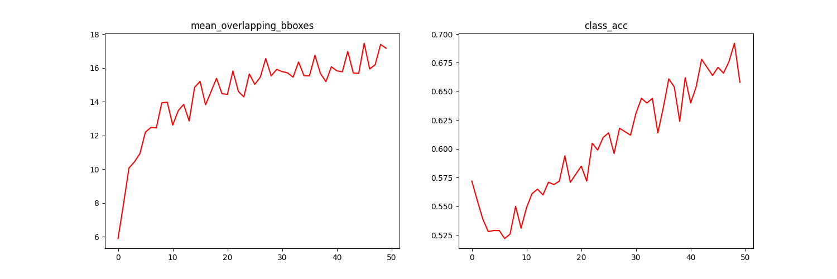
Fast R CNN model Output

Slide 25
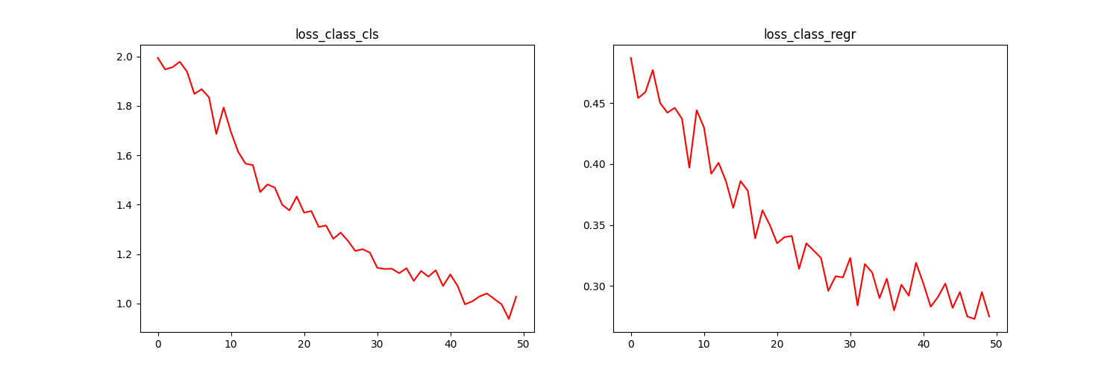
Fast R CNN model Output

Slide 26
Fast R CNN model analysis
With only 50 iterations Fast RCNN model class accuracy improved than the normal CNN model.
But the model needs 2000-3000 iterations to output good results.
Model can be further improved by including rotation angle in the feature extraction process.

Slide 27
Questions?

